Slide 1
CONFERENCIA EEN
SPAIN:
NUESTRAS EMPRESAS
Oviedo, 22nd June 2023

Slide 2

UPINTELLIGENCE S.L.
Who we are?
We are an advanced innovative group focused on offering digital solutions through the use of:
5.0 Technologies
Solutions based on R&D in Artificial Intelligence (AI) for predictive platforms
Digital Twins
Expert management systems
Business Intelligence
Augmented Reality (AR) applications and other types of apps (mobile and web)

Slide 3








RESEARCH AREAS
Who do we work with?
What we do can be applied to any area, although UPintelligence is mainly focused on three sectors:
City councils, Regional and National Bodies, research groups and foundations
Touristic sector
Tourism and Smart Cities, cultural services, etc
Digital health and biotechnology
Health centres and institutions, Universities, public bodies, large health corporations
Industry and food industry

Slide 4

Predictive algorithms
Improve the quality of the decisions
Improve productivity
Anticipate future scenarios
Model based on AI

Slide 5
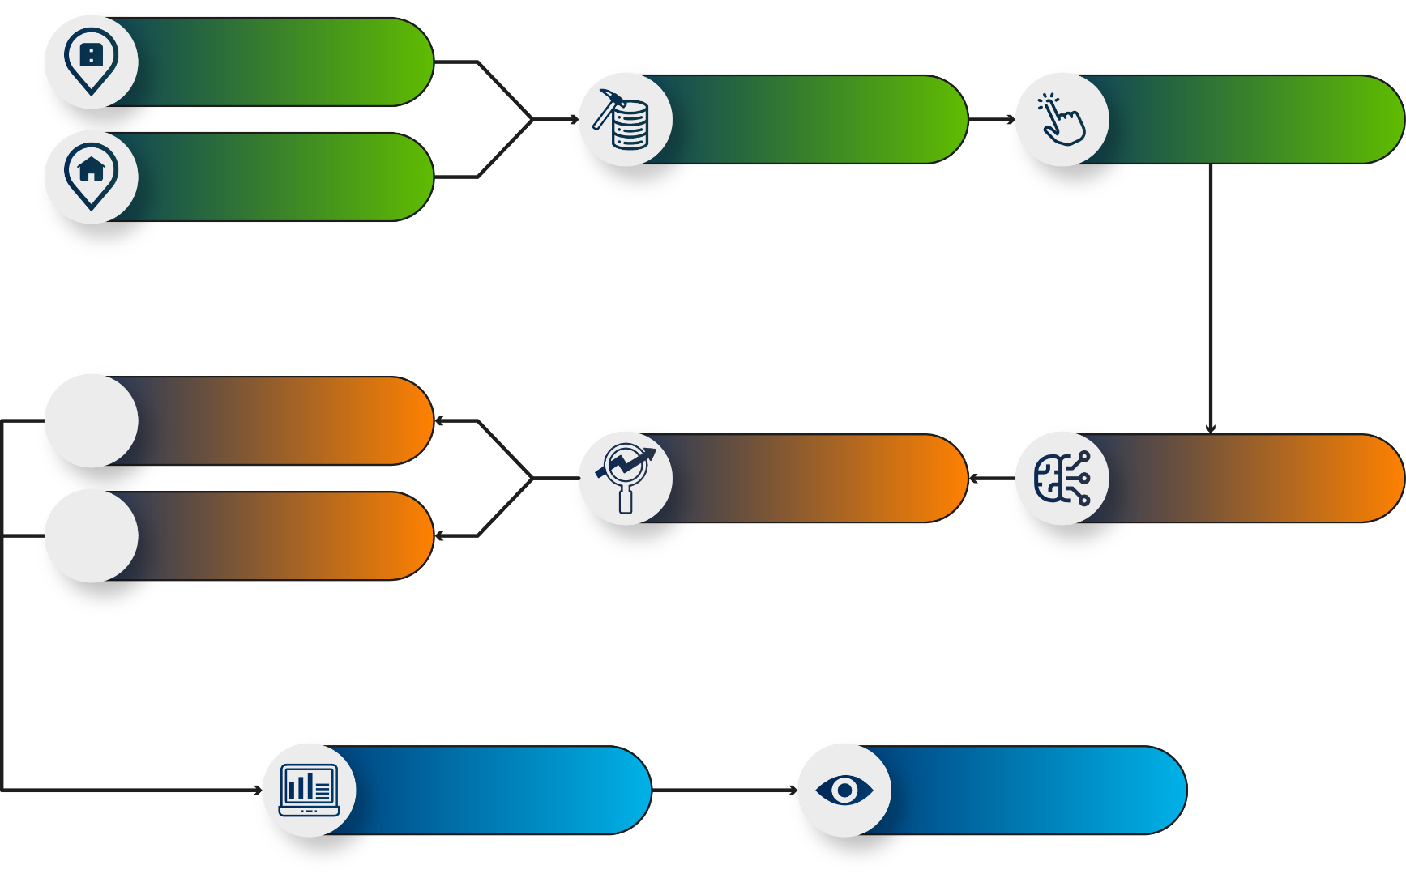


EXTERNAL VARIABLES
DATA MINING
SELECTION OF
VARIABLES
INTERNAL VARIABLES
CONCLUSSIONS
PREDICTION
MACHINE LEARNING/IA
DECISSIONS
DASHBOARD
VISUALIZATION THROUGH
APPLICATIONS

Slide 6







State of the art
Meetings with experts
Data mining
Smart system
AI models
External data bases
Processing algorithms
Features and correlations
Maximum information
Algorithms according to data
Benchmarking
App web
Display
Authentication sistem
Data export (PDF,CSV, Excel, images…)
PDF report with NLP algorithms

Slide 7
5.0 Technology:
NLP
ARTIFICIAL
INTELLIGENCE
BIG DATA
DIGITALIZATION

Slide 8
BENEFITS OF EEN-GALACTEA SERVICES
Diagnosis of innovation with Improve tool
We detected áreas of improvement and obtained a complete visión about our strategy and culture of innovation
Information about European calls
EICPathfinder, PharaOn, Horizon (health and industry), EIT Raw materials,…
Preparation and submission of 10+ proposals thanks to the EEN support and information
Innovative Public Procurement
Technological opportunities:
Partner seach for calls and consortiums,
Ficyt
Jovellanos fellowship for funding personnel dedicated to R&D: two projects funded
Technology transfer calls: funding of activities in 2021 and 2022

