Slide 1


22/6/2023 EEN Oviedo
Mobility –
Transport - Automotive
Sector Group meeting

Slide 2
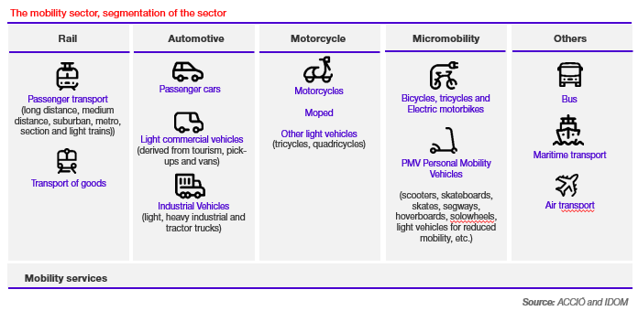
Main figures of the automotive – transport and mobility sector

Slide 3
Automotive, Transport and Mobility Sector Group
Chair of the ATM SG: Riánsares López
Co-chair of the ATM SG: ?
Number of participants: 80
Active members: 33
Countries represented: 17 (26)

Slide 4

Sector Group Meetings 2023
1st SG meeting (April 18-19)
Eindhoven
2nd SG meeting (October 3-5)
Luxemburg
Online meetings

Slide 5
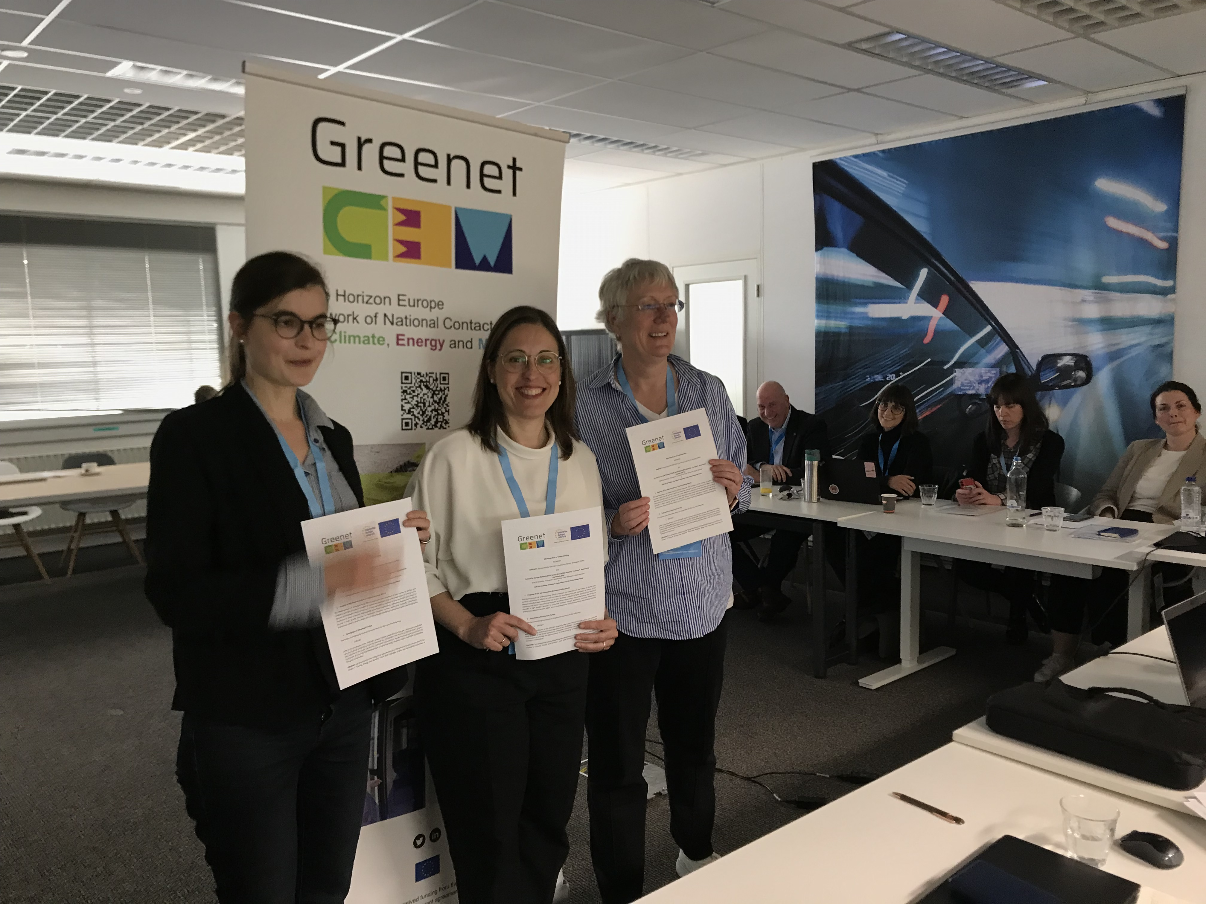
Annual Work Plan 2023
Objective
Increase synergies among the clients of our regions to increase partnerships agreements
Proposed Annual Work Plan 2023
Signature of a MOU with the GREENET PLATFORM which is the NCP
EIT URBAN MOBILITY /RAW MATERIALS /INNOENERGY
Industrial alliances
PACK4Skills
HORIZON RESULTS PLATFORM (HRP) Pilot
Notes:
European Battery Alliance (EBA)
European Raw materials alliance (ERMA)
Alliance on Processors and Semiconductors Technologies https://digital-strategy.ec.europa.eu/en/policies/alliance-processors-and-semiconductor-technologies
Alliance for Industrial DATA, Edge and Cloud

Slide 6
Thank you!
Follow us
@EEN_EU
#EENCanHelp
Follow us at

